Slide 1
Credit Card Usage Segmentation
Presented By: Rahul Thakur

Slide 2
Agenda
01 Introduction
02 Data Collection
03 Preprocessing
04 EDA
05 Methodology
06 Model Evaluation
07 Conclusion

Slide 3
Introduction
Credit card usage segmentation involves dividing customers into distinct groups based on their spending patterns, transaction behaviors, and demographics.
The primary objectives of segmentation include targeted marketing, risk management, product development, and revenue optimization. By identifying specific customer needs, companies can enhance their strategies to improve conversion rates, manage risk, and create products that resonate with different segments.
Key factors in segmentation include spending patterns, payment behavior, demographic characteristics, product usage, and credit risk.

Slide 4
Workflow
Data Collection
Preprocessing
EDA
Modelling
Evaluation

Slide 5
Data
The dataset captures credit card usage behavior with features like balance, purchases, cash advances, payment frequencies, and credit limits. It also includes metrics like one-off vs. installment purchases, transaction counts, and tenure. This data aids in understanding spending patterns for effective customer segmentation and financial strategy development.
BALANCE: The current amount owed on the credit card. It reflects the user's spending and payment activity.
1
PURCHASES: Total amount spent on the credit card. This includes all types of purchases made by the customer.
2
CASH_ADVANCE: The amount of cash taken out against the credit card limit. It indicates the user's need for cash and potential financial behavior.
3
CREDIT_LIMIT: The maximum amount that can be charged to the card. It defines the credit capacity available to the customer.
4
PAYMENTS: Total payments made towards the credit card balance. This shows the customer's payment behavior and financial responsibility.
5
TENURE: The number of months the customer has been with the credit card issuer. It provides insight into customer loyalty and engagement.
6

Slide 6

Preprocessing
Handling Missing Values:
The CUST_ID column was dropped as it wasn't relevant for analysis. For missing values, CREDIT_LIMIT had only one missing value, which was filled with the mean. For MINIMUM_PAYMENTS, missing values were handled based on the payment status: if payments were zero, MINIMUM_PAYMENTS was filled with zero; otherwise, it was filled with the mean.
Feature Scaling:
MinMax scaling was applied to the dataset. This choice was made after testing both MinMax and standard scaling methods, with MinMax scaling yielding better model performance.
Encoding Categorical Variables:
No encoding was required as all features were already numeric (either integer or float).

Slide 7
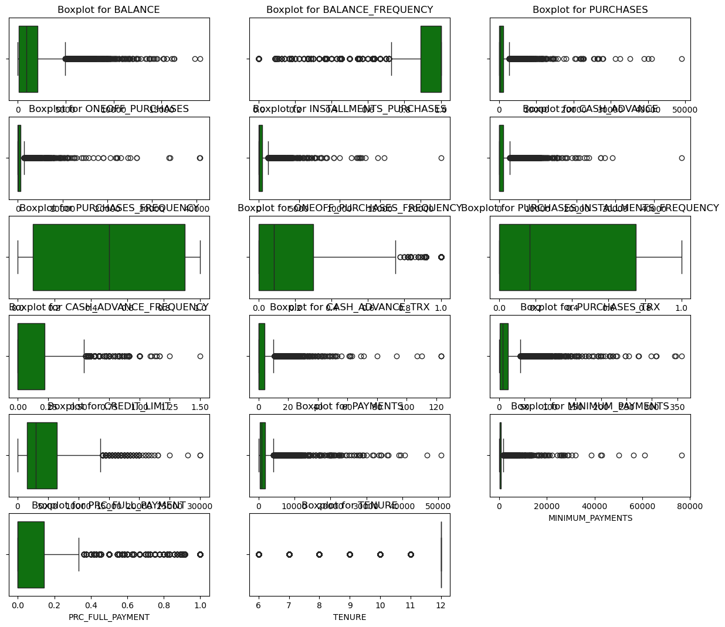
EDA
BOXPLOTS
The boxplots in this slide illustrate the distribution of various credit card usage metrics across customers. Each plot provides insights into the central tendency, variability, and presence of outliers for the corresponding feature.
Key Observations:
BALANCE and PURCHASES: These features exhibit a wide range of values, with a significant number of outliers indicating that some customers have much higher balances and purchase amounts compared to others.
CREDIT_LIMIT and PAYMENTS: The distributions for these features are also right-skewed, with outliers suggesting that while most customers have moderate credit limits and payments, a few have significantly higher values.
Interpretation:
The presence of outliers and varying distributions across features suggests diverse credit card usage behaviors among customers, which supports the need for segmentation to better understand and serve different customer groups.

Slide 8
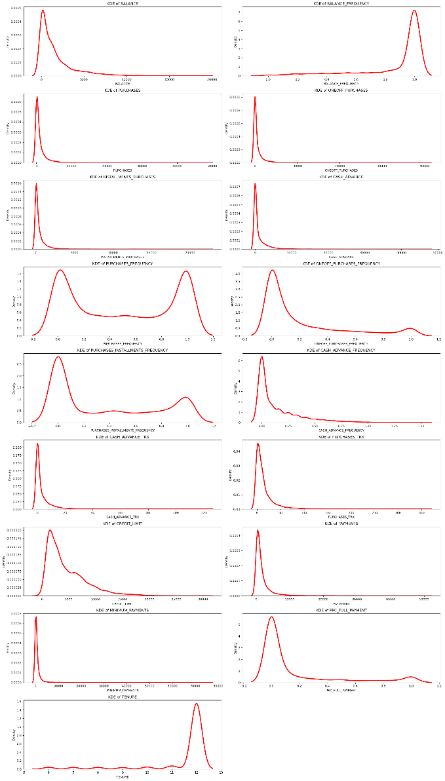
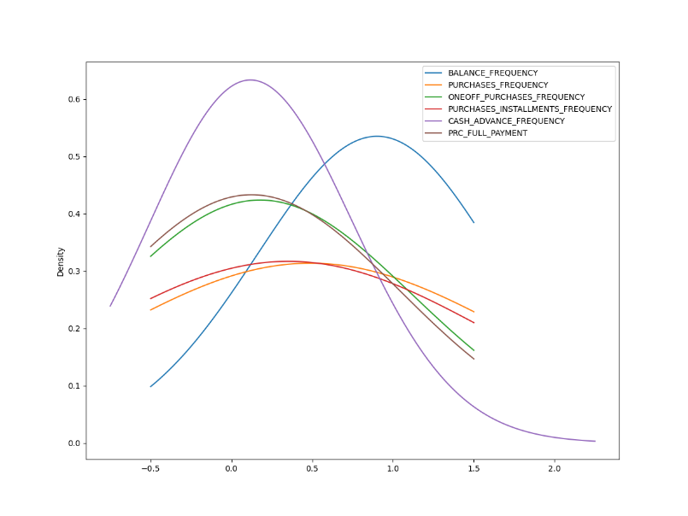
KDE
Feature Distributions: Most features, such as BALANCE, PURCHASES, and CREDIT_LIMIT, show highly right-skewed distributions, indicating that most customers have low values, with only a few having significantly high ones.
Frequency-Based Features: Features like BALANCE_FREQUENCY and PURCHASES_FREQUENCY have more normal or multimodal distributions, suggesting varied customer behaviors—some use their cards frequently, others infrequently.
Segmentation Insights: Peaks in frequency features indicate distinct customer segments, such as moderate and extensive users. These insights help identify customer segments for targeted marketing and risk management strategies.

Slide 9
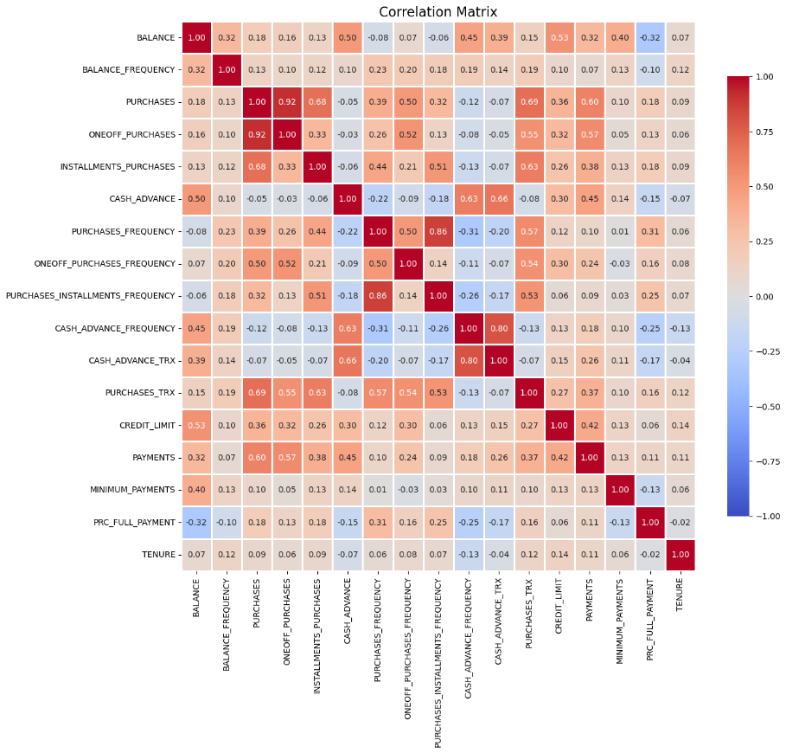
Correlation Matrix
The correlation matrix illustrates the relationship between different features, with values ranging from -1 (strong negative correlation) to +1 (strong positive correlation).
Strong positive correlations can be observed between PURCHASES and ONEOFF_PURCHASES, indicating that as one increases, so does the other.
BALANCE is positively correlated with CREDIT_LIMIT and PAYMENTS.
This matrix is crucial for understanding the linear relationships between variables, which is helpful for further modeling steps.

Slide 10
Model Selection
Models used:
K-Means Clustering: Partitions data into K clusters by minimizing the sum of squared distances within each cluster. It’s a simple, iterative algorithm often used for its speed and efficiency.
Hierarchical Clustering: Agglomeratively merges clusters to minimize within-cluster variance using Ward linkage. Flexible with no need for a predefined number of clusters. Other linkages include single, complete, and average.
Gaussian Mixture: Models data as a mixture of Gaussian distributions, allowing soft clustering. Uses tied covariance where all components share a matrix. Other covariance types include full, diagonal, and spherical for flexibility.
DBSCAN: Groups densely packed points into clusters while identifying noise as outliers. It’s non-parametric, doesn’t require specifying the number of clusters, and is effective in detecting clusters of varying shapes and sizes.

Slide 11
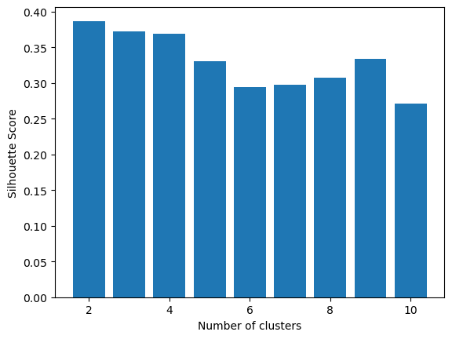
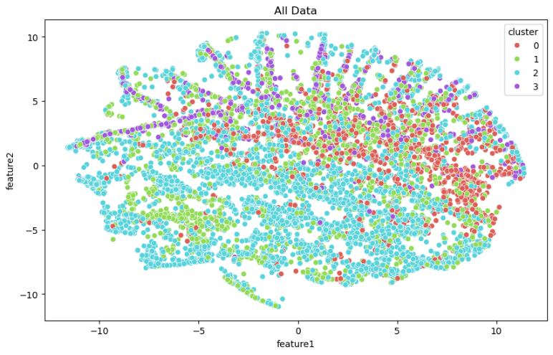
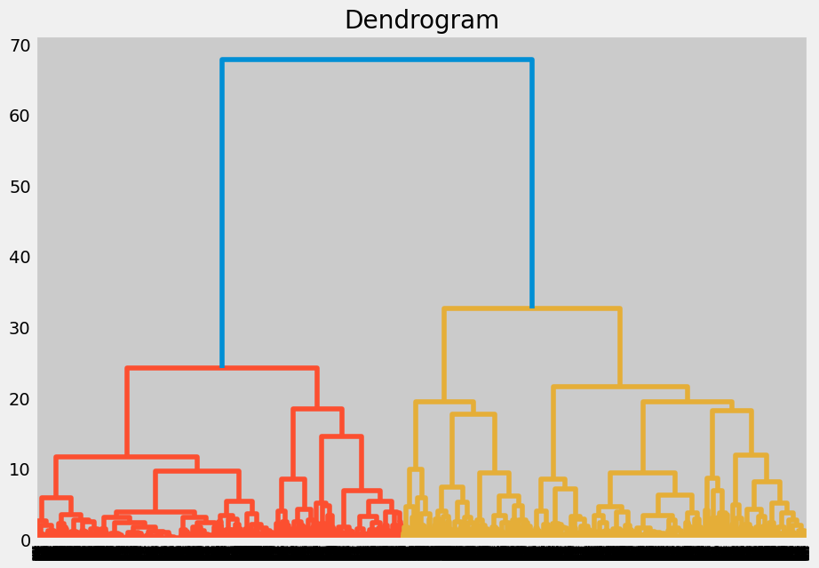
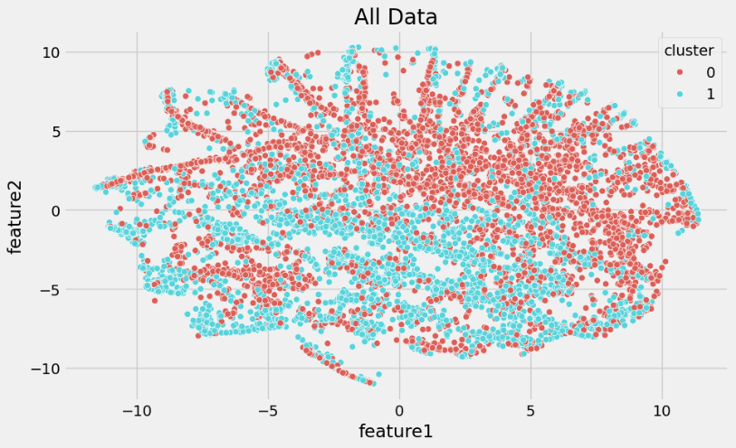
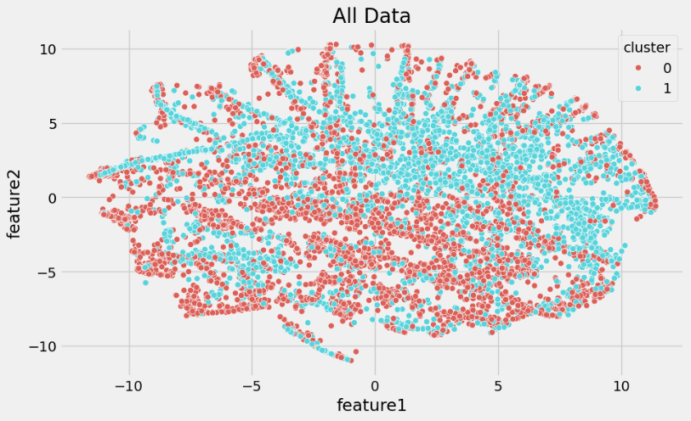
Model cluster visualization
Silhouette Score for KMeans
T-SNE plot for KMeans
Dendrogram for Agglomerative Clustering
T-SNE plot for Agglomerative Clustering
T-SNE plot for Gaussian Mixture

Slide 12
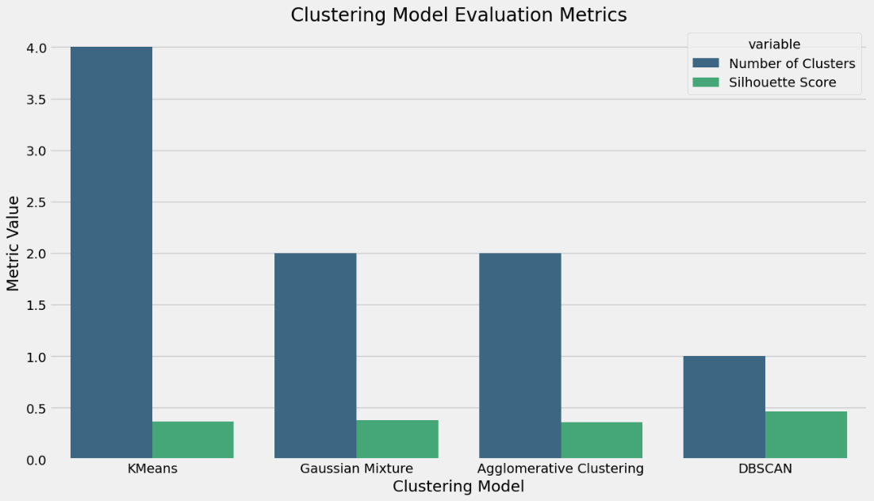
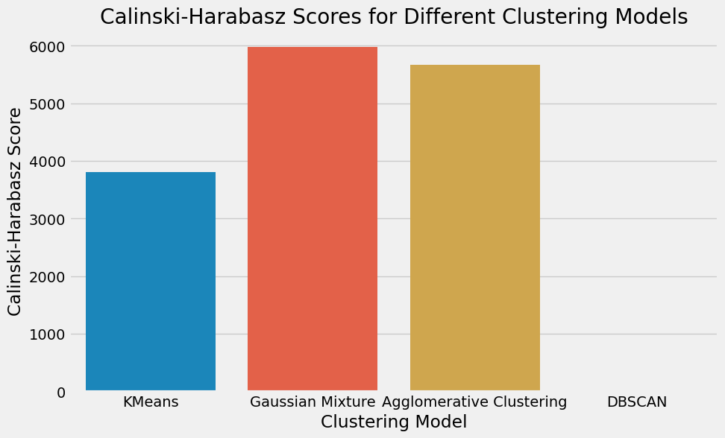
Model Evaluation
I have used 3 metrics to evaluate the models, Silhouette Score, Calinski Harabasz Index, Davies Bouldin Score
The bar plot evaluates clustering models using the Calinski-Harabasz Score and Silhouette Score.
Gaussian Mixture and Agglomerative Clustering have high Calinski-Harabasz scores, indicating well-defined clusters.
The Silhouette Score suggests that KMeans and Gaussian Mixture models have better separation between clusters compared to others.

Slide 13
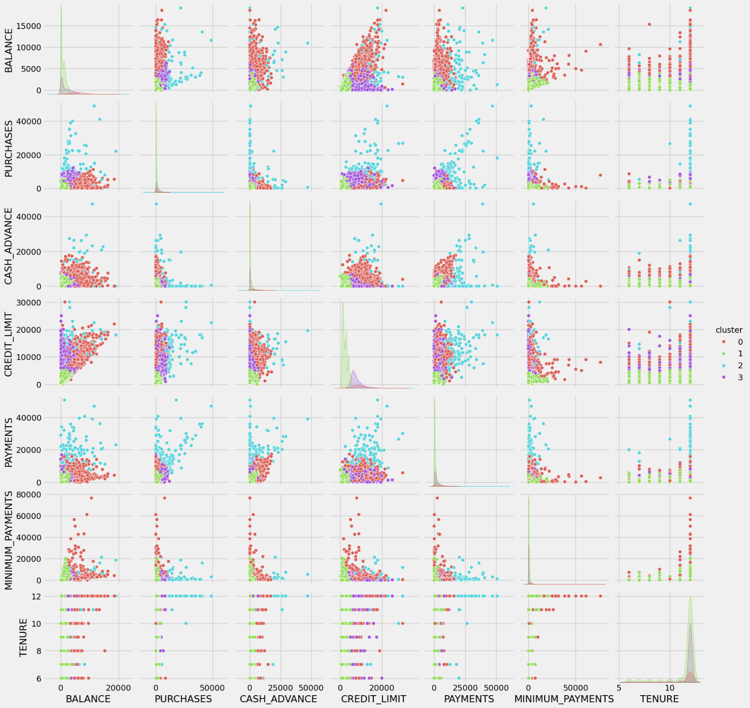
Conclusion
The pair plot presents a scatterplot matrix of features, with clusters highlighted using different colors (Red for Cluster 0, Green for Cluster 1, Blue for Cluster 2, and Purple for Cluster 3).
This visualization helps in understanding how different features separate the data into distinct clusters, providing insights into the distribution and overlap of clusters.

Slide 14
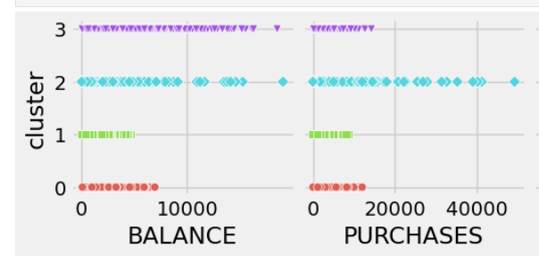
Cluster Analysis
Cluster 0 (Red): Customers in this group tend to have the lowest balances, purchases, credit limits, and payments. They are likely light users of credit cards, possibly new or infrequent customers who do not rely heavily on credit.
Cluster 1 (Green): This cluster represents customers who have moderate balances and credit limits, but relatively low purchases and payments. These customers may manage their credit conservatively, with a focus on maintaining a steady but controlled use of their available credit.
Cluster 2 (Blue): Customers in this segment have higher balances and purchases, along with significant credit limits and payments. These are likely active credit card users who utilize their cards for various transactions and manage larger amounts of money, indicating they might be high-value customers.
Cluster 3 (Purple): This group includes customers who have high balances, credit limits, purchases, and payments. They likely use their credit cards extensively, not only for purchases but also for large payments, which suggests they might be leveraging their credit for substantial financial activities or investments.

Slide 15
Questions ?

Slide 16
Thank You!

